Slide 1


Artificial Intelligence Course Overview
A Theoretical and Practical Integration for Computer Science Students
Created by,
Supervisor
Tanvir Shahriar,
Razoshri Prozzowal Talukdar
5th Semester
Duration
July 2025 to December 2025

Slide 2

Introduction to Artificial Intelligence (AI)
AI is the field of computer science dedicated to creating machines capable of performing tasks that typically require human-like intelligence, such as reasoning, learning, and perception.
Simulating the Mind
Goal-Oriented Behavior
AI seeks to simulate core human cognitive processes: perception, learning, memory, and decision-making through algorithms and data structures.
Non-human entities (robots, software) exhibit a 'mind' via adaptive learning and goal-oriented actions, distinct from human consciousness.
Defining Categories of AI
Thinking Humanly
Acting Humanly
Thinking Rationally
Acting Rationally

Slide 3
Intelligent Agents: Perception and Action
An intelligent agent is an entity that perceives its environment using sensors and acts upon that environment using actuators. Its primary goal is to maximize performance by selecting the most optimal sequence of actions.
Simple Reflex Agent
Relies solely on condition–action rules, ignoring past history or environment state.
Model-Based Reflex Agent
Maintains an internal state (a model of the world) to make better, context-aware decisions.
Goal-Based Agent
Uses goal information to guide action selection, choosing paths that lead directly to the desired outcome.
Utility-Based Agent
Maximizes a defined utility function, choosing actions that result in the highest 'happiness' or overall best outcome.
Learning Agent
Continuously improves performance and knowledge base through experience and feedback from the environment.

Slide 4




Four Foundational Approaches of AI
These four perspectives guide the development and evaluation of AI systems, focusing on either human mimicry or rational perfection.
Thinking Humanly
Acting Humanly
The cognitive modeling approach: Mimicking internal human thought processes and reasoning patterns.
The Turing Test approach: Creating systems whose behavior is indistinguishable from a human's (e.g., chatbots).
Acting Rationally
Thinking Rationally
The rational agent approach: Selecting the best possible action to achieve specific outcomes, independent of human psychology.
The "laws of thought" approach: Relying on formal logic and inference to deduce the correct conclusions.
These approaches help clarify the objectives of various AI systems, from psychological modeling to practical, goal-achieving robots.

Slide 5

AI Environments and State Space Search
Understanding the environment is crucial for agent design. Agents navigate the complex landscape of possible actions and outcomes using state space search techniques.
Agent Environment Characteristics
Fully vs. Partially Observable
Deterministic vs. Stochastic
Episodic vs. Sequential
Static vs. Dynamic
Discrete vs. Continuous
A state space includes all possible configurations or states a problem-solving system can transition between.
The Role of State Space Search
State space search is the process of exploring potential actions to find a sequence of steps that moves the agent from an initial starting state to a defined goal state.

Slide 6

Uninformed Search Algorithms
These algorithms are blind—they operate without any domain-specific knowledge or heuristic estimate of the path cost to the goal, systematically exploring the state space.
1
2
3
Breadth First Search (BFS)
Depth First Search (DFS)
Depth Limited Search (DLS)
Explores all nodes at the present depth level before moving to the next level. Optimal for finding the shortest path in terms of the number of steps.
Explores one branch as deep as possible before backtracking. Efficient in terms of memory usage, but not guaranteed to find the shortest path.
DFS variant that limits the maximum depth explored to avoid infinite loops in deep or infinite spaces.
4
5
Iterative Deepening Search (IDS)
Bidirectional Search
Combines DFS's space efficiency with BFS's completeness and optimality (when edge costs are uniform).
Runs concurrent searches forward from the start and backward from the goal, aiming to meet in the middle, often resulting in faster solution times.
Example: The 8-puzzle problem can be solved by simple BFS or DFS, but the lack of guiding heuristics can make it computationally intensive.

Slide 7
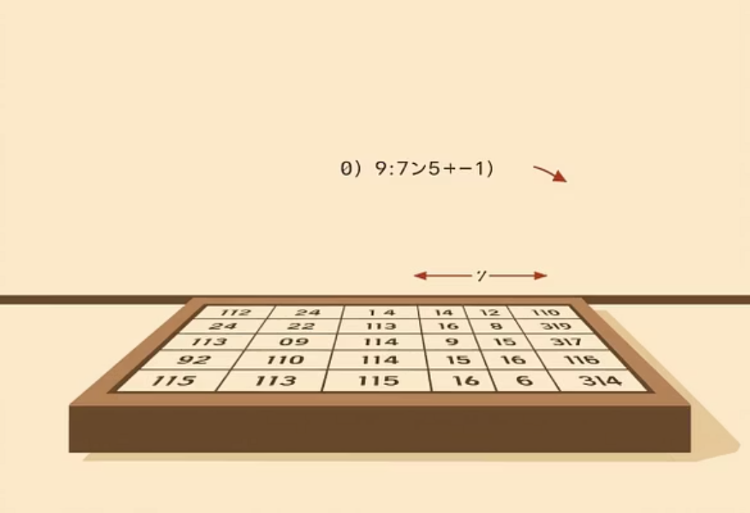
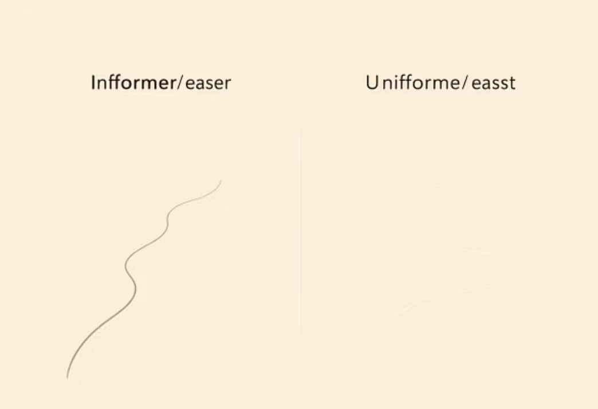
Heuristic and Informed Search
Informed search algorithms use a heuristic function—an estimate of the remaining cost—to intelligently guide the search and find solutions much faster than uninformed methods.
Heuristic Guidance
Efficiency Gain
8-Puzzle Example Heuristics
A heuristic acts as a "rule of thumb," providing an informed guess to prioritize states that seem closer to the goal.
By directing the search, informed algorithms dramatically reduce the portion of the state space that needs to be explored.
Common heuristics include counting misplaced tiles or calculating the Manhattan distance (total distance of all tiles from their goal positions).

Slide 8
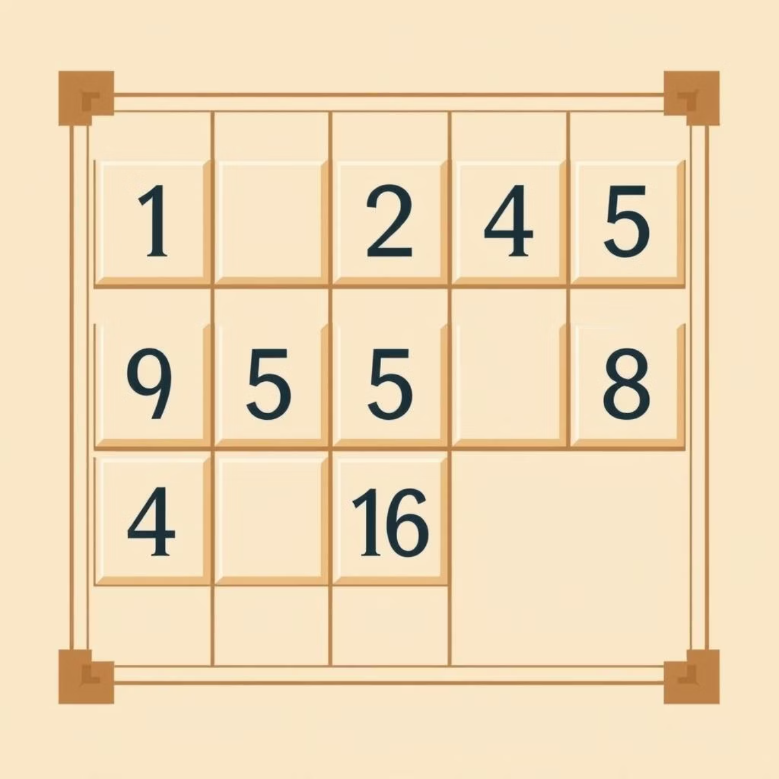
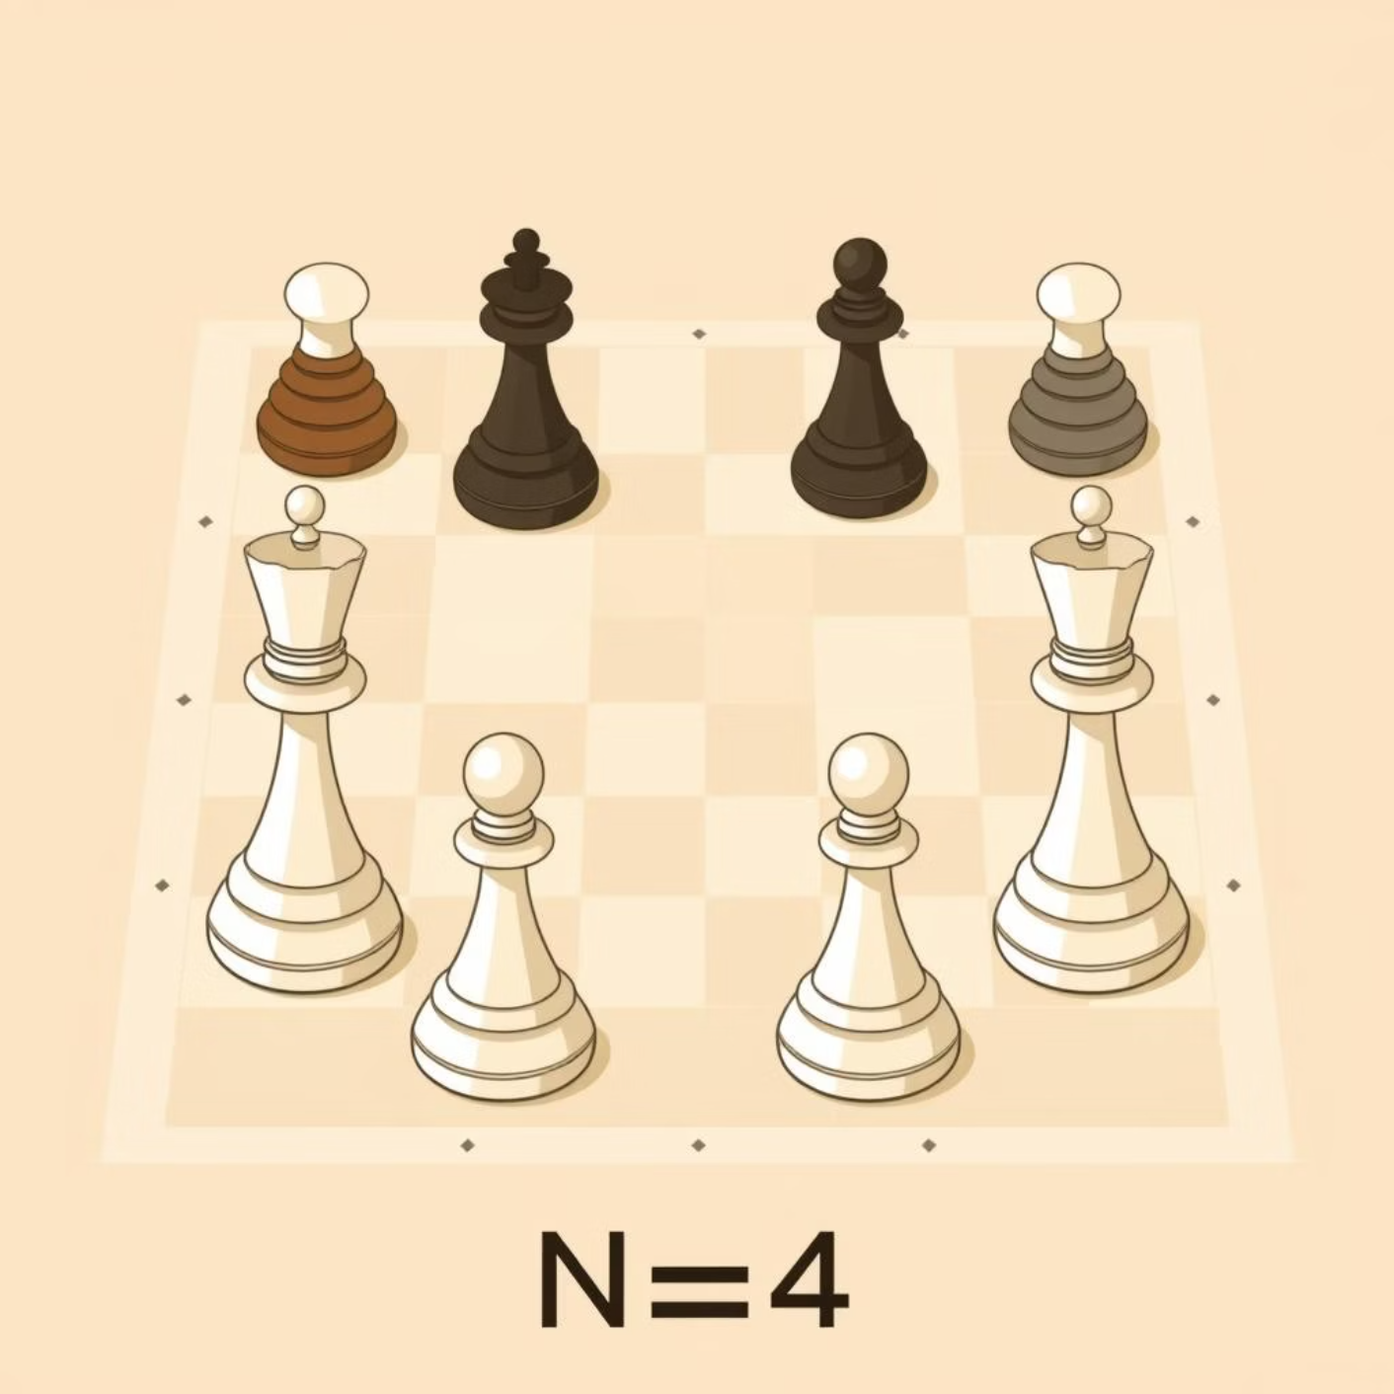
Classic Problems in AI: Search and Constraint Satisfaction
These two classic problems illustrate different aspects of AI search and optimization techniques—from finding optimal paths to satisfying complex constraints.
8-Puzzle with Heuristic
The N-Queen Problem
The 8-Puzzle is a sliding block puzzle used to benchmark search algorithms. By employing informed search algorithms like A* Search or Best-First Search with a good heuristic, the solution is found optimally and quickly.
This is a constraint satisfaction problem: Place N non-attacking queens on an N×N chessboard. Solutions often rely on local search or backtracking algorithms to efficiently navigate the solution space while respecting all constraints.

Slide 9
Advanced Search Algorithms: Optimizing Pathfinding
These algorithms build upon basic search concepts to guarantee optimality, handle costs, and manage complex decision graphs.
Best First Search
A* Search
Greedy approach that expands the node estimated to be closest to the goal based on a heuristic function h(n).
Combines the path cost from the start g(n) and the heuristic estimate h(n). It is widely used for optimal pathfinding: f(n) = g(n) + h(n).
A* Admissible Heuristic
AO* Algorithm
A heuristic is admissible if it never overestimates the true cost to reach the goal. Admissibility guarantees that A* will find the optimal solution.
An extension of A* designed to solve problems represented by AND/OR graphs, which are common in planning and expert systems involving conditional dependencies.
A* is the benchmark for informed pathfinding in AI, balancing efficiency and guarantee of optimality.

Slide 10
Optimization and Game Search
Specific algorithms are required for finding optimal solutions in continuous spaces (optimization) and making tactical decisions in adversarial environments (game theory).
Hill Climbing Algorithm
Beam Search
A local search technique that iteratively moves in the direction of increasing value until a local maximum (peak) is reached. Prone to getting stuck in local optima.
A variation of Best-First Search that restricts the number of best nodes (the "beam width") kept at each level, trading optimality for computational efficiency.
Min–Max Algorithm
Alpha–Beta Pruning
Used in two-player, zero-sum games (like Chess). It determines the optimal move by assuming the opponent will also play optimally to minimize the player's gain.
An optimization technique for the Min–Max algorithm. It dramatically cuts down the number of nodes evaluated by eliminating branches that are guaranteed not to affect the final outcome.

